Slide 1

WELCOME TO:
General Meeting
6 PM Tuesday, September 18, 2018
Broun Hall, Room 125

Slide 2
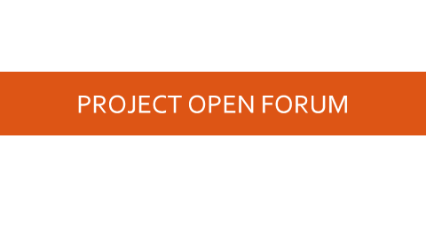
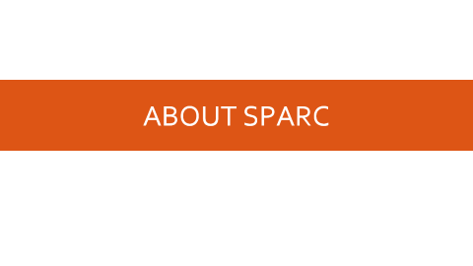
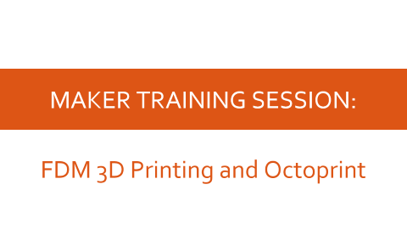
AGENDA

Slide 3
ABOUT SPARC

Slide 4
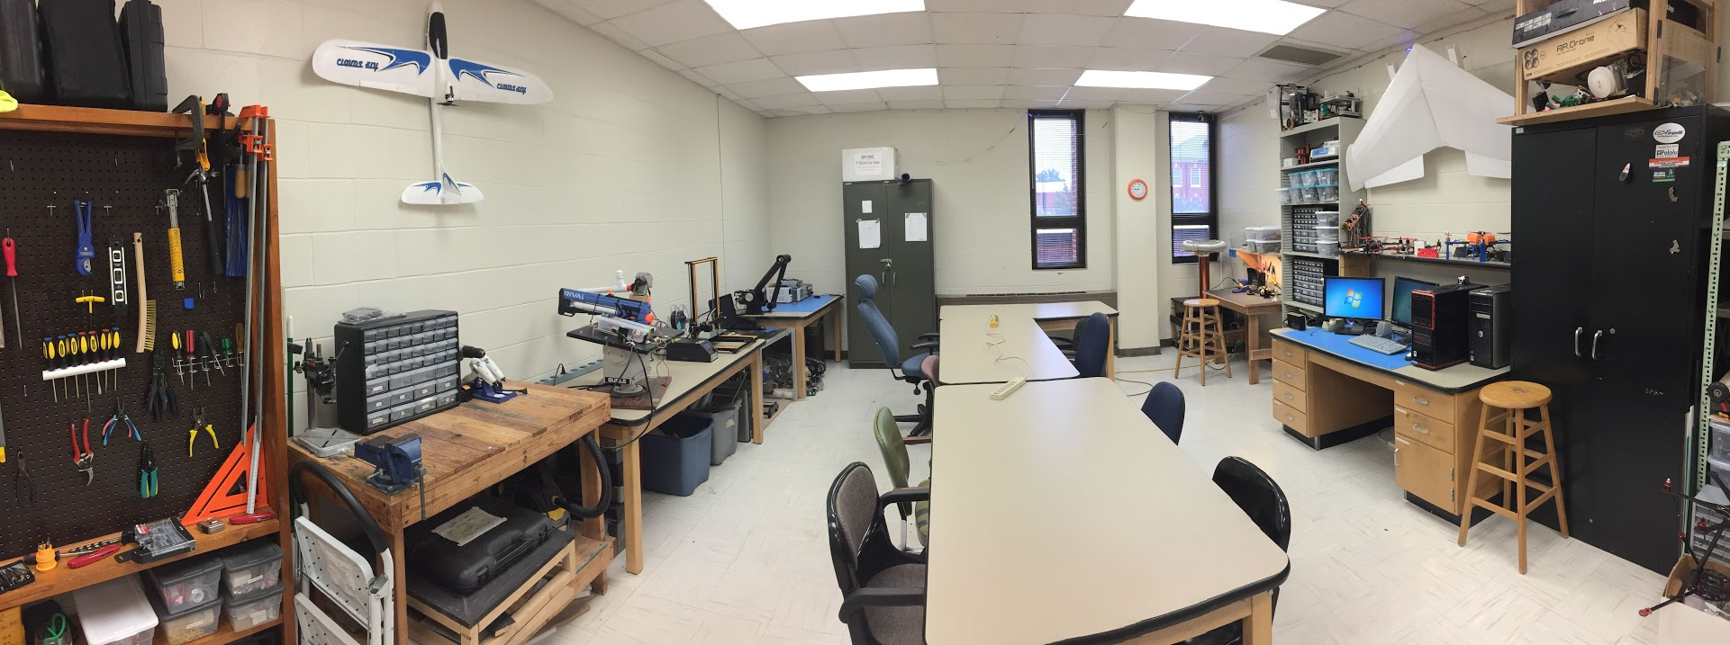
ABOUT SPARC
Creates and fosters an environment of creativity and innovation through collaborative projects.
A place to test out ideas, integrate concepts learned in class, and learn skills that will be instrumental when working in the workforce.
No prior experience is required, only a willingness to learn.
Lab:
- Broun 367
General Meetings:
- Tuesdays @ 6 in Broun 125
Project Meetings:
- Various Times during week

Slide 5
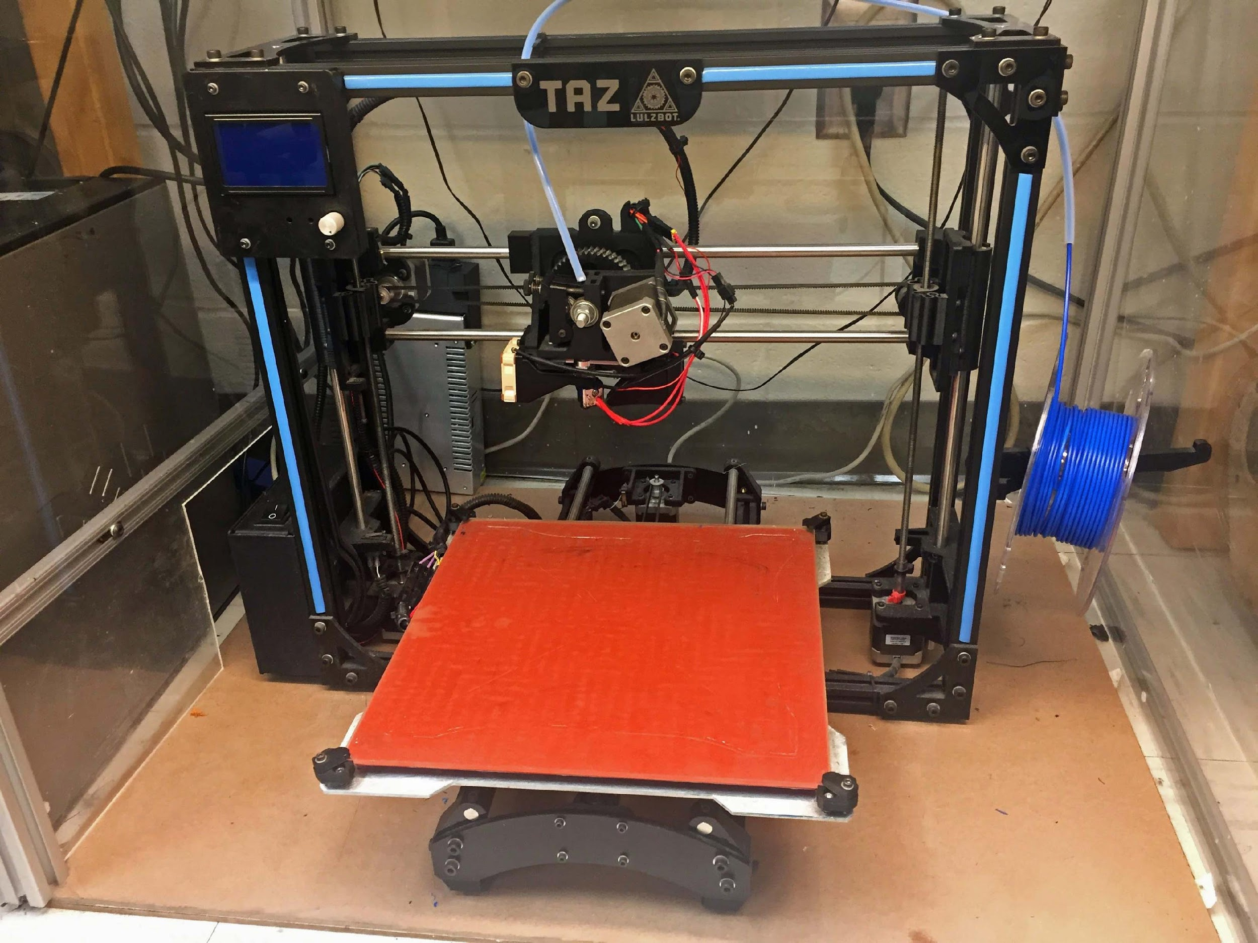
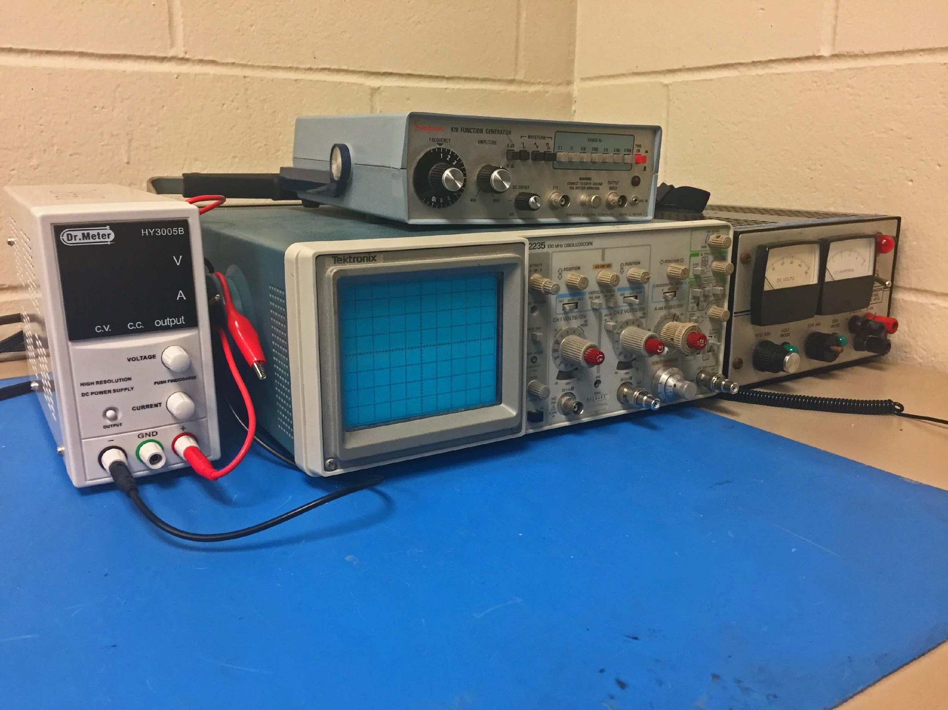
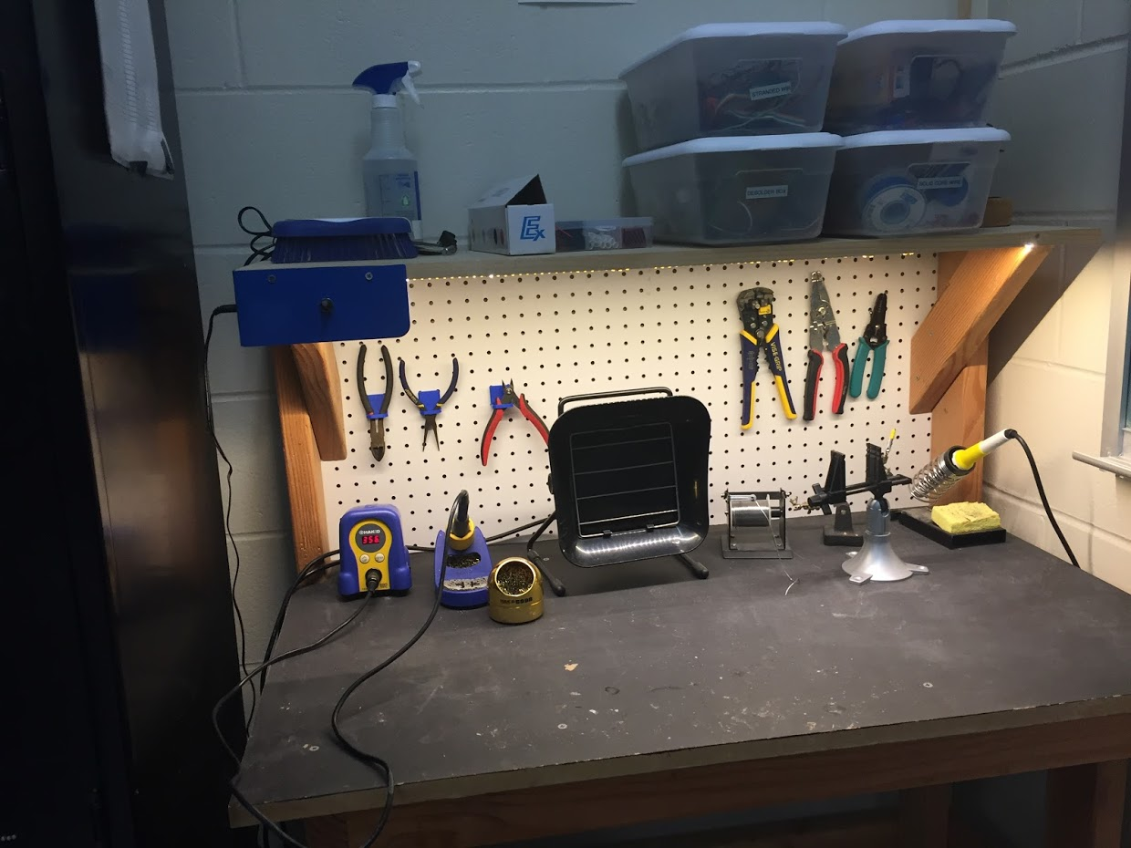
OUR LAB
Broun Hall
Room 367

Slide 6
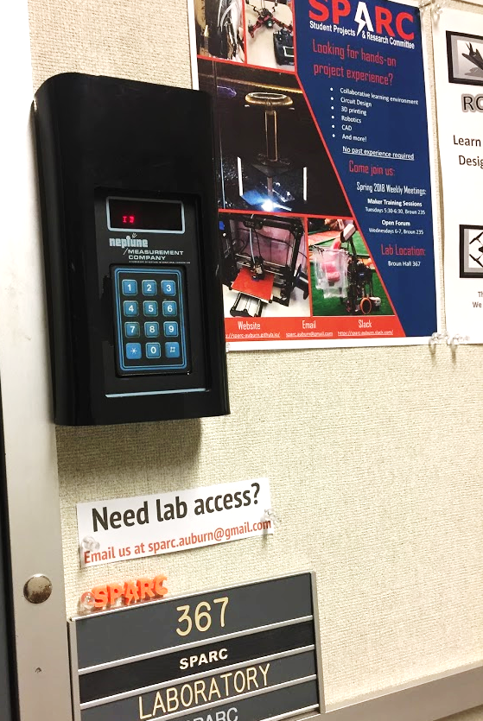
HOW TO BECOME A MEMBER
Log 5 constructive hours in the lab
Write the times on the sheet on the clipboard next to the door.
Contact us at sparc.auburn@gmail.com
We will respond with the instructions to get an access code.

Slide 7




MORE INFORMATION ABOUT SPARC
Website
http://sparc.eng.auburn.edu/
Github
https://github.com/SPARC-Auburn
Slack
https://sparc-auburn.slack.com/
Email
sparc.auburn@gmail.com

Slide 8
QUESTIONS?
Notes:
6:10

Slide 9
OUTREACH AND RECRUITMENT

Slide 10
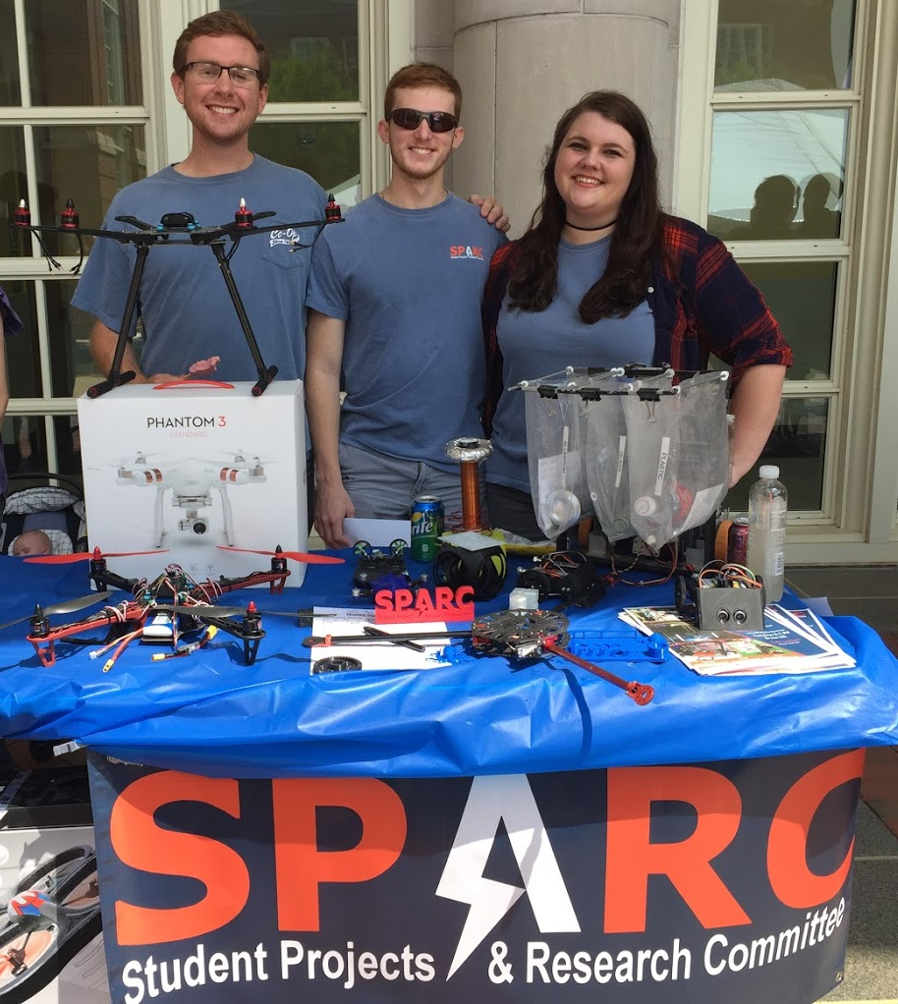
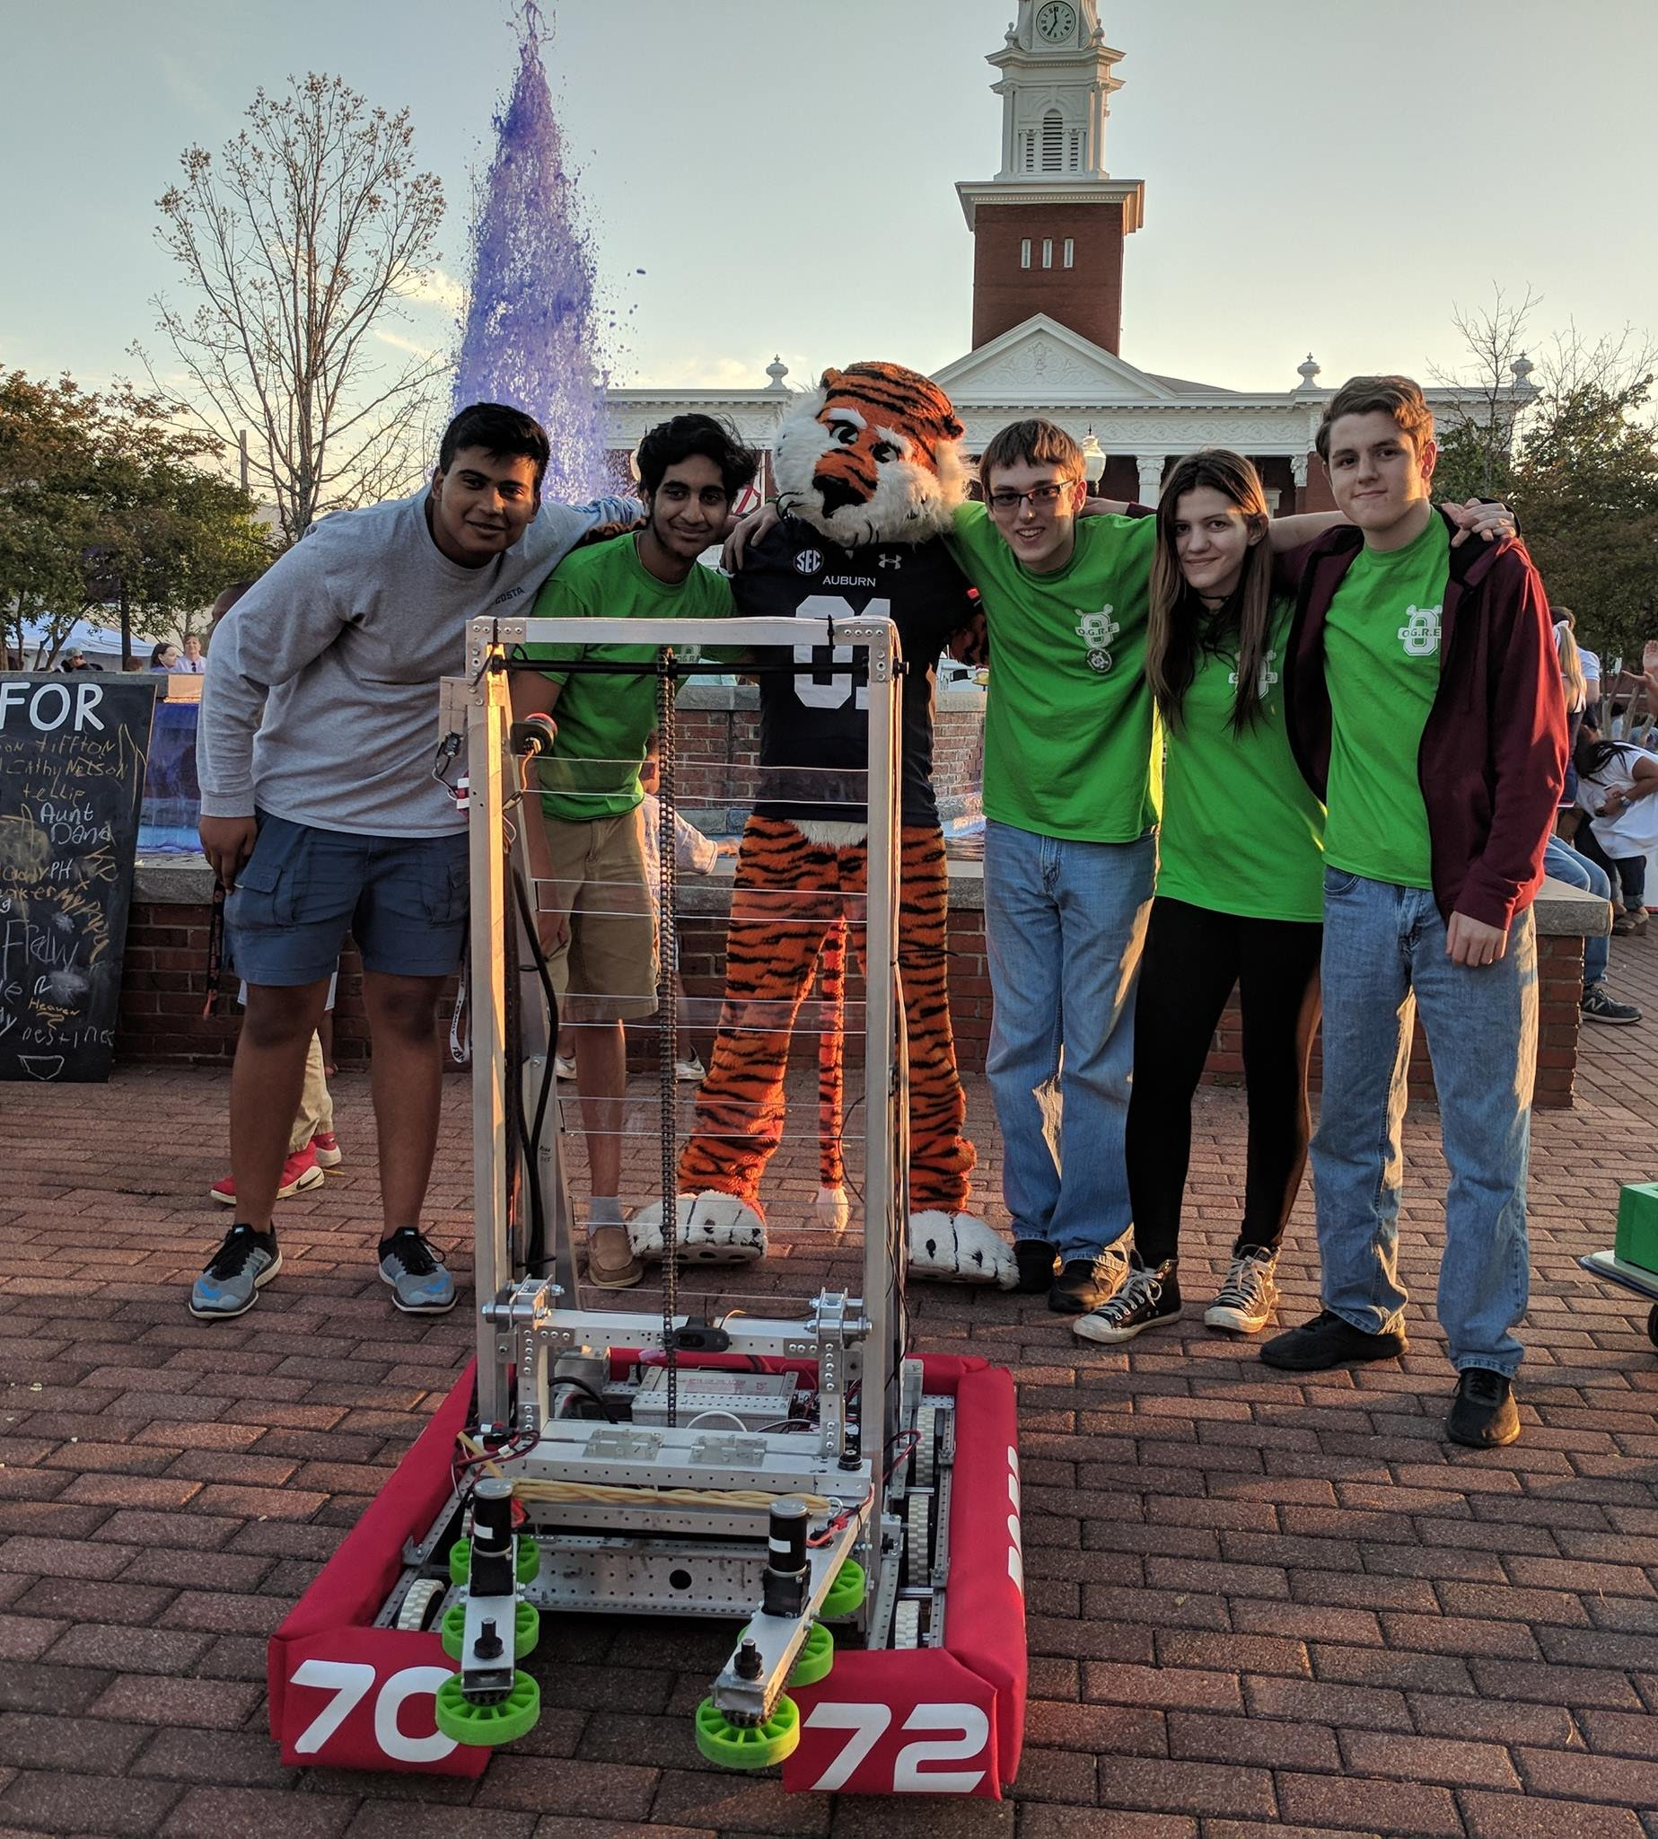
UPCOMING EVENTS
Opelika HS Robotics Team
Help mentor a local robotics team
Times: TWR: 3:30-6:30pm
Contact: Matthew Zacune <maz0006@auburn.edu>
Engineering BBQ 2018
FRC Team 7072 Bot
Notes:
Fall 2016
Loachapoka Robotics Mentoring- Mondays, Tuesdays, and Thursdays 3:00PM to 4:30PM
ECE Minority Presentation- November 14th
AJHS E-Day- November 17th
South’s Best- December 3-4th
SCORE Claw Machine- December 3-4th
Spring 2016
E-Day- Late February or early March
SPACE Day- Possible Event Next Semester
IEEE Sumo Robotics Competition (with local middle and high schools)- Spring 2017

Slide 11
PROJECT OPEN FORUM

Slide 12
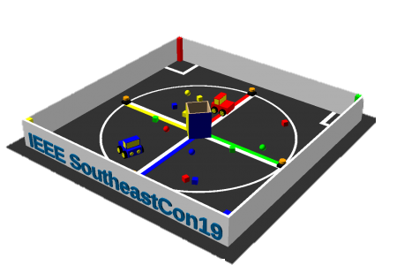
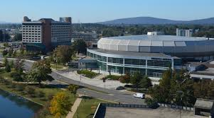
MAJOR PROJECT #1: IEEE SOUTHEAST CON
Project lead: Matthew Castleberry
Electrical lead: Josh Jablonowski
Mechanical lead: Alex Jones
Slack Channel: #projectieee
Competition Details:
Build a “space debris” collecting robot
Goal is to collect wood blocks and ball pit balls and deposit them on the side of a small flat ~100” square arena autonomously.
Max dimensions: 9” x 9” x 11”
When and Where:
Thursday, April 11th, 2019 through Sunday, April 14th, 2019.
IEEE Southeastcon conference in Huntsville, AL
Meeting Times
Electrical/Software Meeting: Tuesdays 12:30 - 2
Mechanical Meeting: Mondays 3 - 5

Slide 13
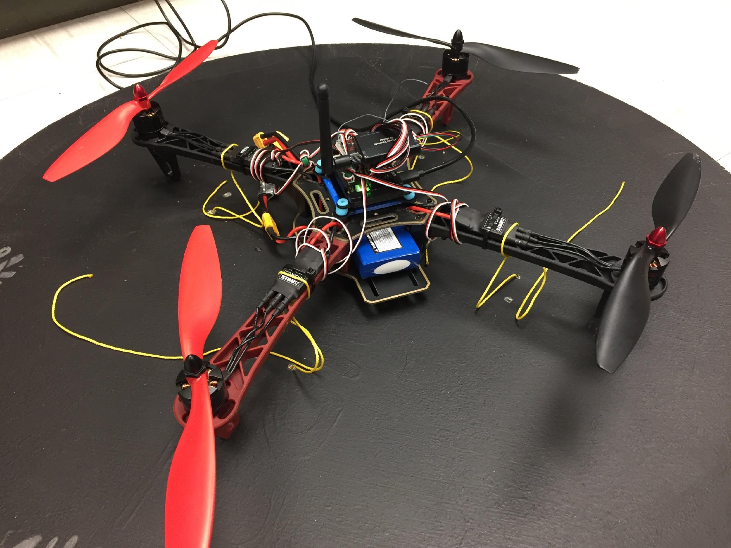
MAJOR PROJECT #2: MAIL BIRD
Project Lead: Joshua Parker
Slack Channel: #projectmailbird
Will be used to experiment with payload pickup, identification, and delivery
Partnership with RC Hobbyist Club
Semester Focus
Configure frame for waypoint navigation, etc.
Develop package release mechanism
Meeting Times
Wednesdays 11am – 1pm

Slide 14
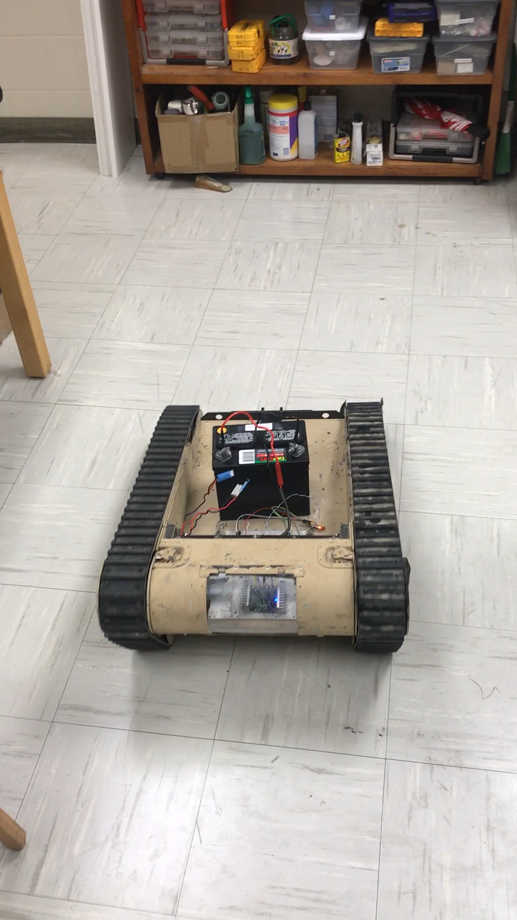
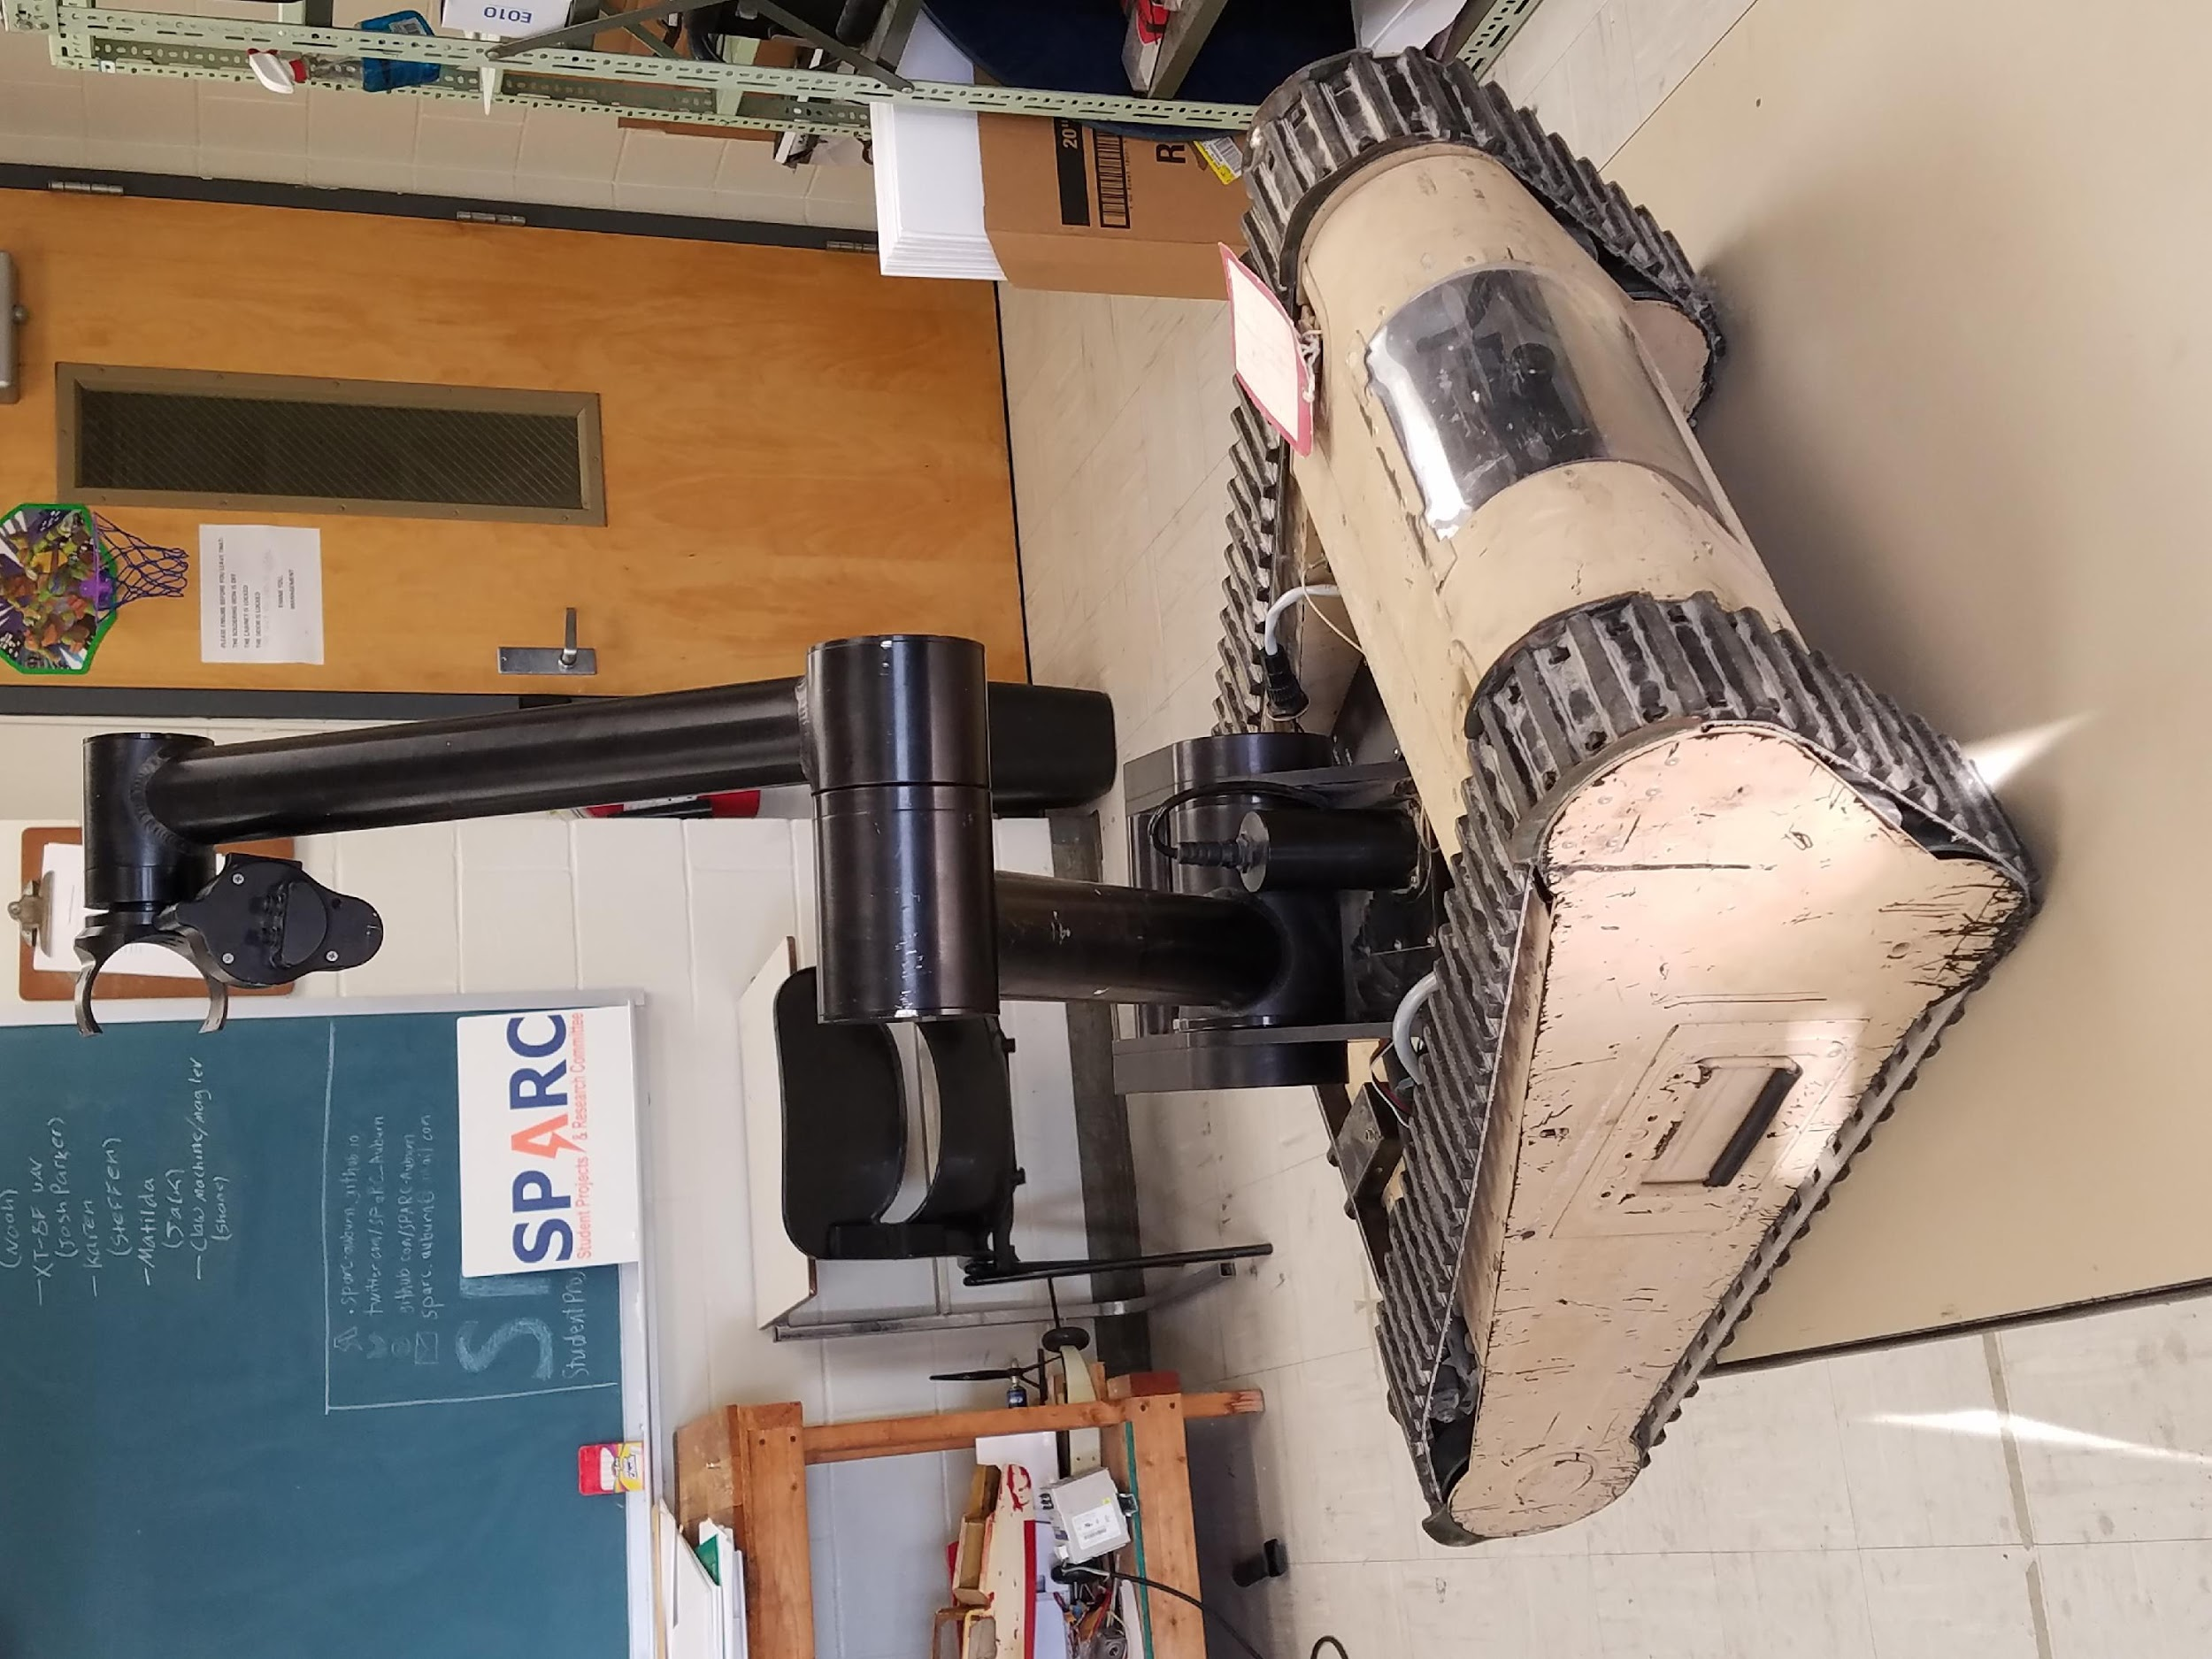
MAJOR PROJECT #3: MATILDA
Slack Channel: #projectmatildarm
Project lead: Alex Jones
Slack Channel: #projectmatildabase
Project lead: Ryan Moran
MATILDA stands for Mesa Associates' Tactical Integrated Light-Force Deployment Assembly
A bomb disposal robot from Dr. Roppel’s research lab.
2 Sub-teams:
Base: Fridays 11:30 – 12:30
Arm: Thursdays 12:30 - 2
Semester Focus
Reestablishing mobility with wireless control
Develop arm to play chess

Slide 15
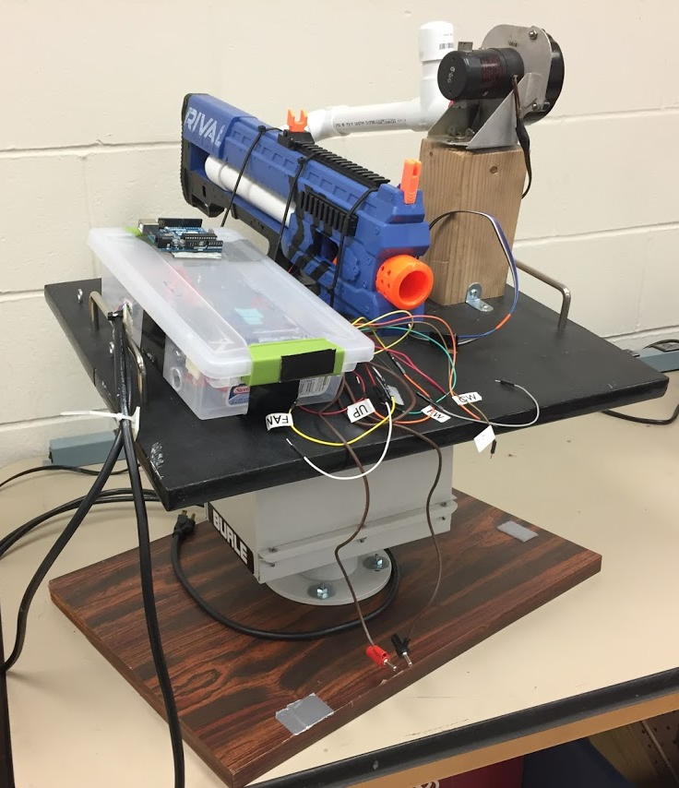
SIDE PROJECT #1: The Helpful Automated Defender (THAD)
Project lead: TBD
Slack Channel: #projectthad
Old project donated by EE department
It was demonstrated last spring at E-Day and PEAK.
Needs a new purpose to improve demonstrations

Slide 16
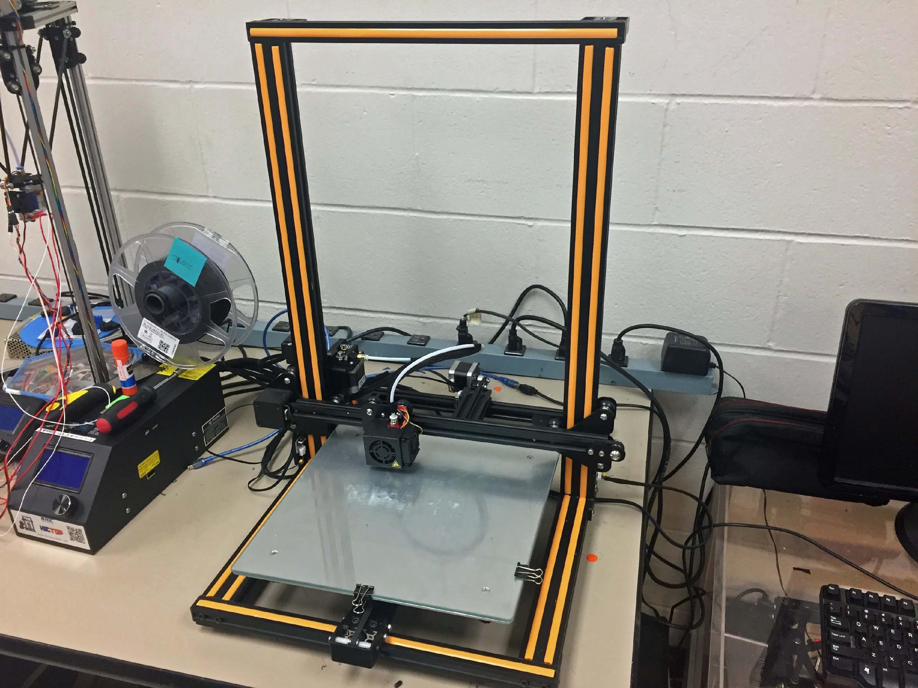
SIDE PROJECT #2: 3D PRINT ENCLOSURE
Project lead: Alex J. and Josh J.
Slack Channel: #3dprinting
Design double decker 3D printer enclosure to hold our Creality CR10 and Lulzbot Taz 3.
Will have wheels and have hinged doors
Will potentially use Octoprint on Raspberry Pi(s) to control printers.

Slide 17
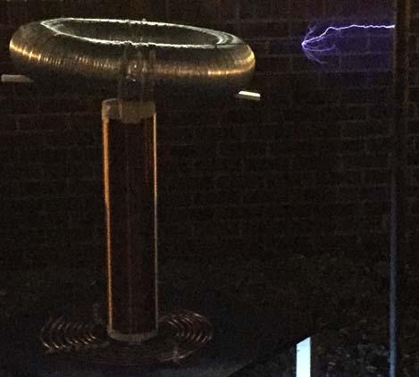
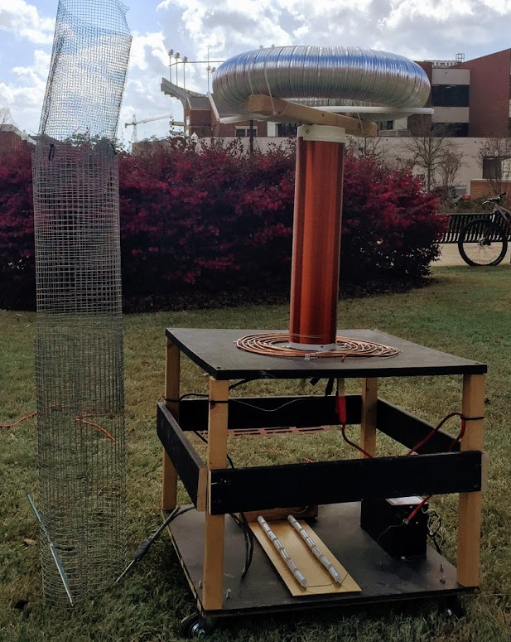
SIDE PROJECT #3: MUSICAL TESLA COIL
Project lead: TBD
Slack Channel: #projectteslacoil
Demonstrated Tesla Coil at Spring 2016/18 E-Days
Currently uses spark gap style circuitry
Generated estimated 400,000 volts of electricity.
Semester Focus:
Convert it into a musical Tesla Coil.
Develop circuit and PCB design for new components

Slide 18
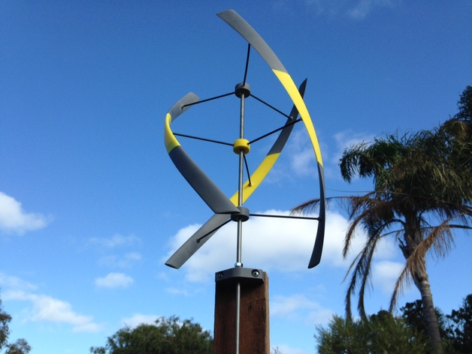
SIDE PROJECT #4: VERTICAL AXIS WIND TURBINE
Project lead: TBD
Slack Channel: TBD
Will create a 3D printed vertical axis wind turbine to generate a small amount of electricity.
Potentially will be used as a cell phone charger.
https://www.thingiverse.com/thing:948401

Slide 19
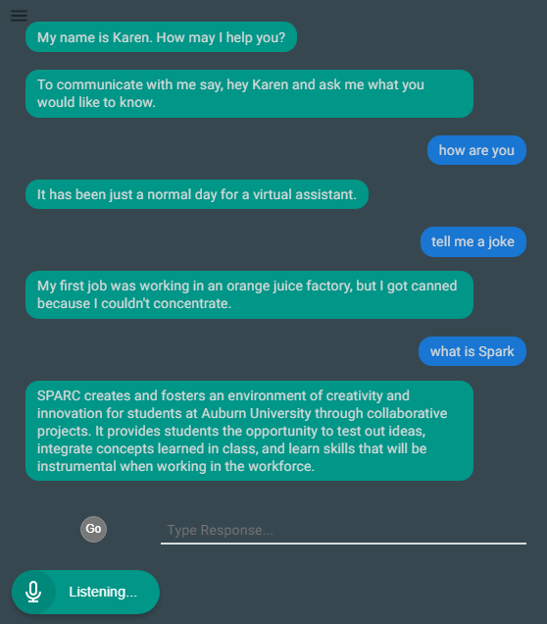
SIDE PROJECT #5: LAB ASSISTANT
Kinematic
Autonomous
Robot
Enriches
Newcomers
Lab
Information
Support
Tool
Project lead: TBD
Slack Channel: #projectlabassistant
Goal: create an automated lab assistant.
Is voice controlled.
One day will consist of both a stationary and mobile system.
Can be embedded on the new group chat system Slack.
Programmed in Node.JS (Framework of JavaScript)
Semester Focus
Add functionality
Add database for keeping track of members and equipment
Slack Channel
#projectlabassistant
Notes:
6:30

Slide 20
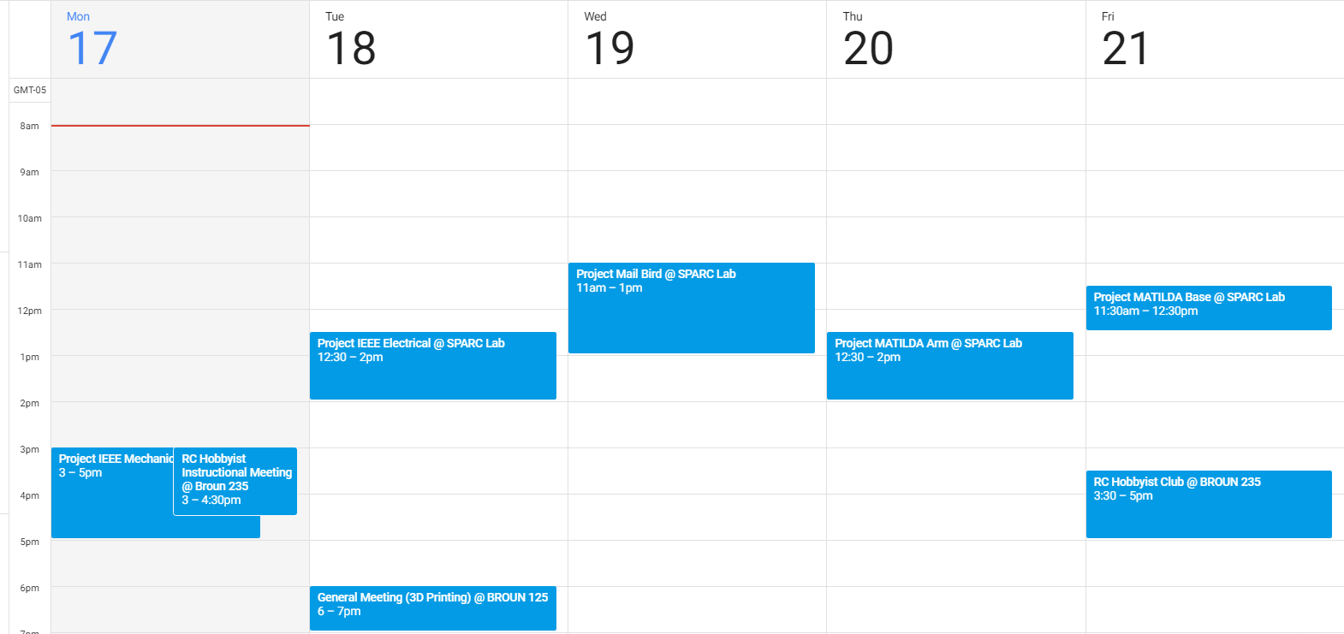
Meeting Schedule

Slide 21
PROJECT IDEAS?
email us at sparc.auburn@gmail.com
or DM Matthew Castleberry @mcberry23 via Slack

Slide 22
MAKER TRAINING SESSION:
FDM 3D Printing and Octoprint

Slide 23
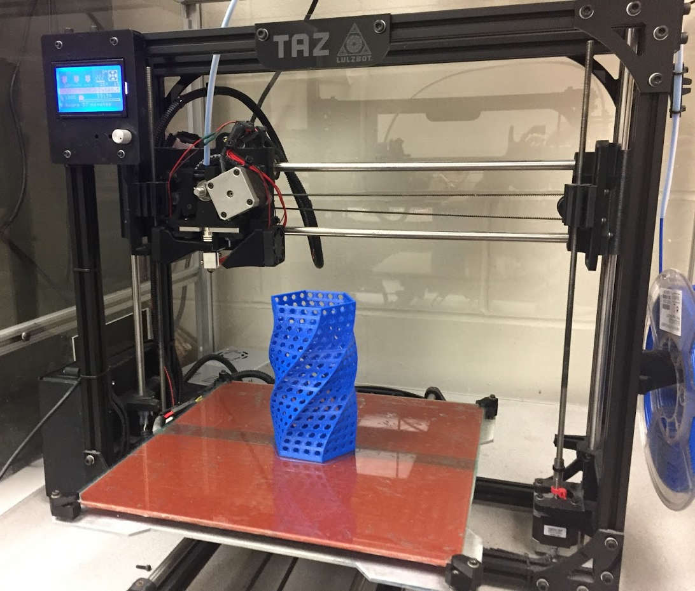
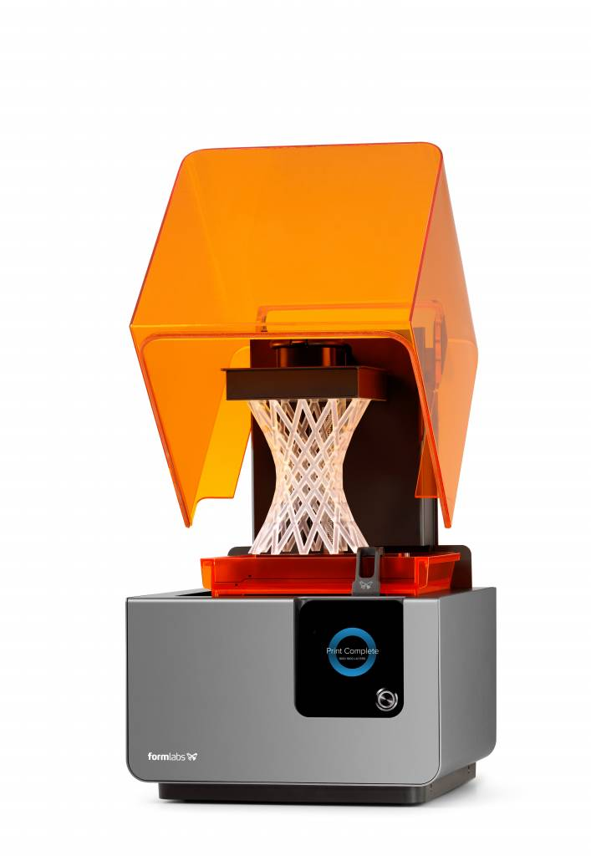
Types of 3D Printers
Filament Based
Fused Deposition Modeling (FDM)- like a glue gun
Resin Based
Stereolithography (SLA)- UV single point laser cured liquid resin
Digital Light Processing (DLP)- light projector cured liquid resin
Powder Based
Selective Laser Sintering (SLS)- laser sintered powder
Selective Laser Melting (SLM)- laser melted powder
Electron Beam Melting (EBM)- electron beam melted powder
Binder Jetting (BJ)- drop-on-powder and binding agent
https://all3dp.com/1/types-of-3d-printers-3d-printing-technology/
SPARC’s FDM Printer
Form 2 SLA Printer

Slide 24
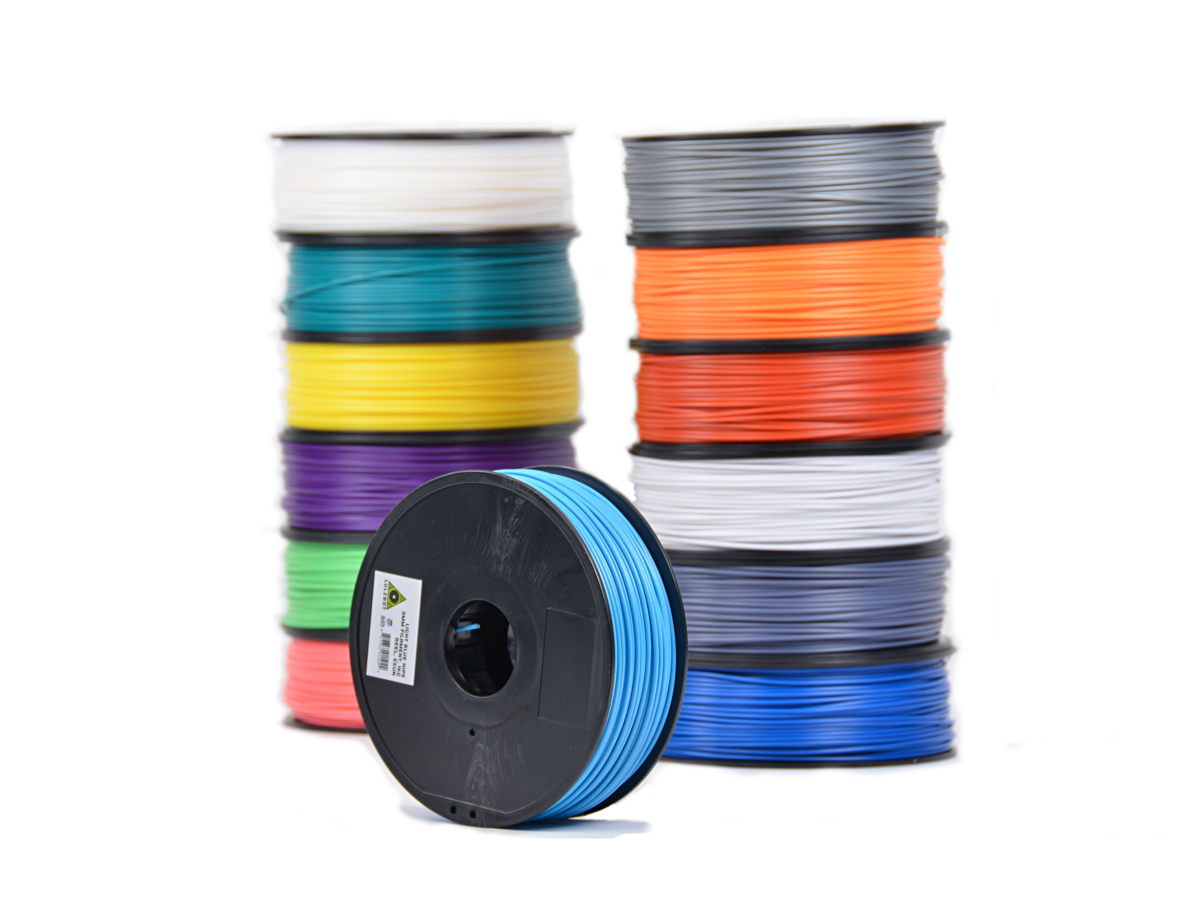
How does FDM 3D Printing Work?
Use a process to form objects in successive layers vertically.
Use a “hot end” that works similar to a glue gun by melting a plastic filament to print each layer.
Many have heated beds to allow better heat distribution preventing the warping of printed objects.
Many use a honeycomb like internal structure to save material and time.
Examples of most popular 3D printing filaments:
ABS
PLA/PLA+
HIPS
Nylon

Slide 25
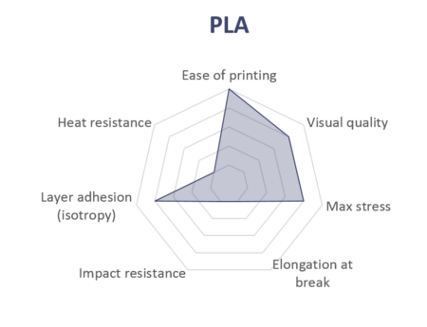
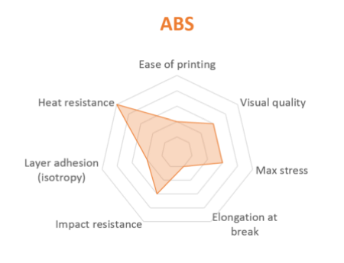
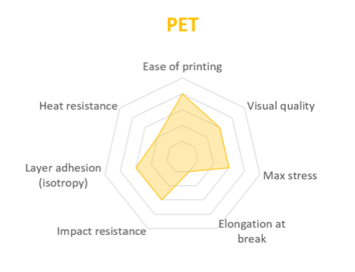
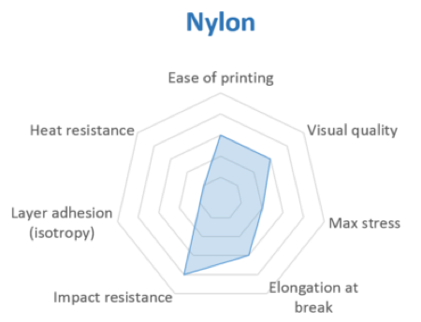
Comparing Popular Filaments
https://www.3dhubs.com/knowledge-base/fdm-3d-printing-materials-compared

Slide 26
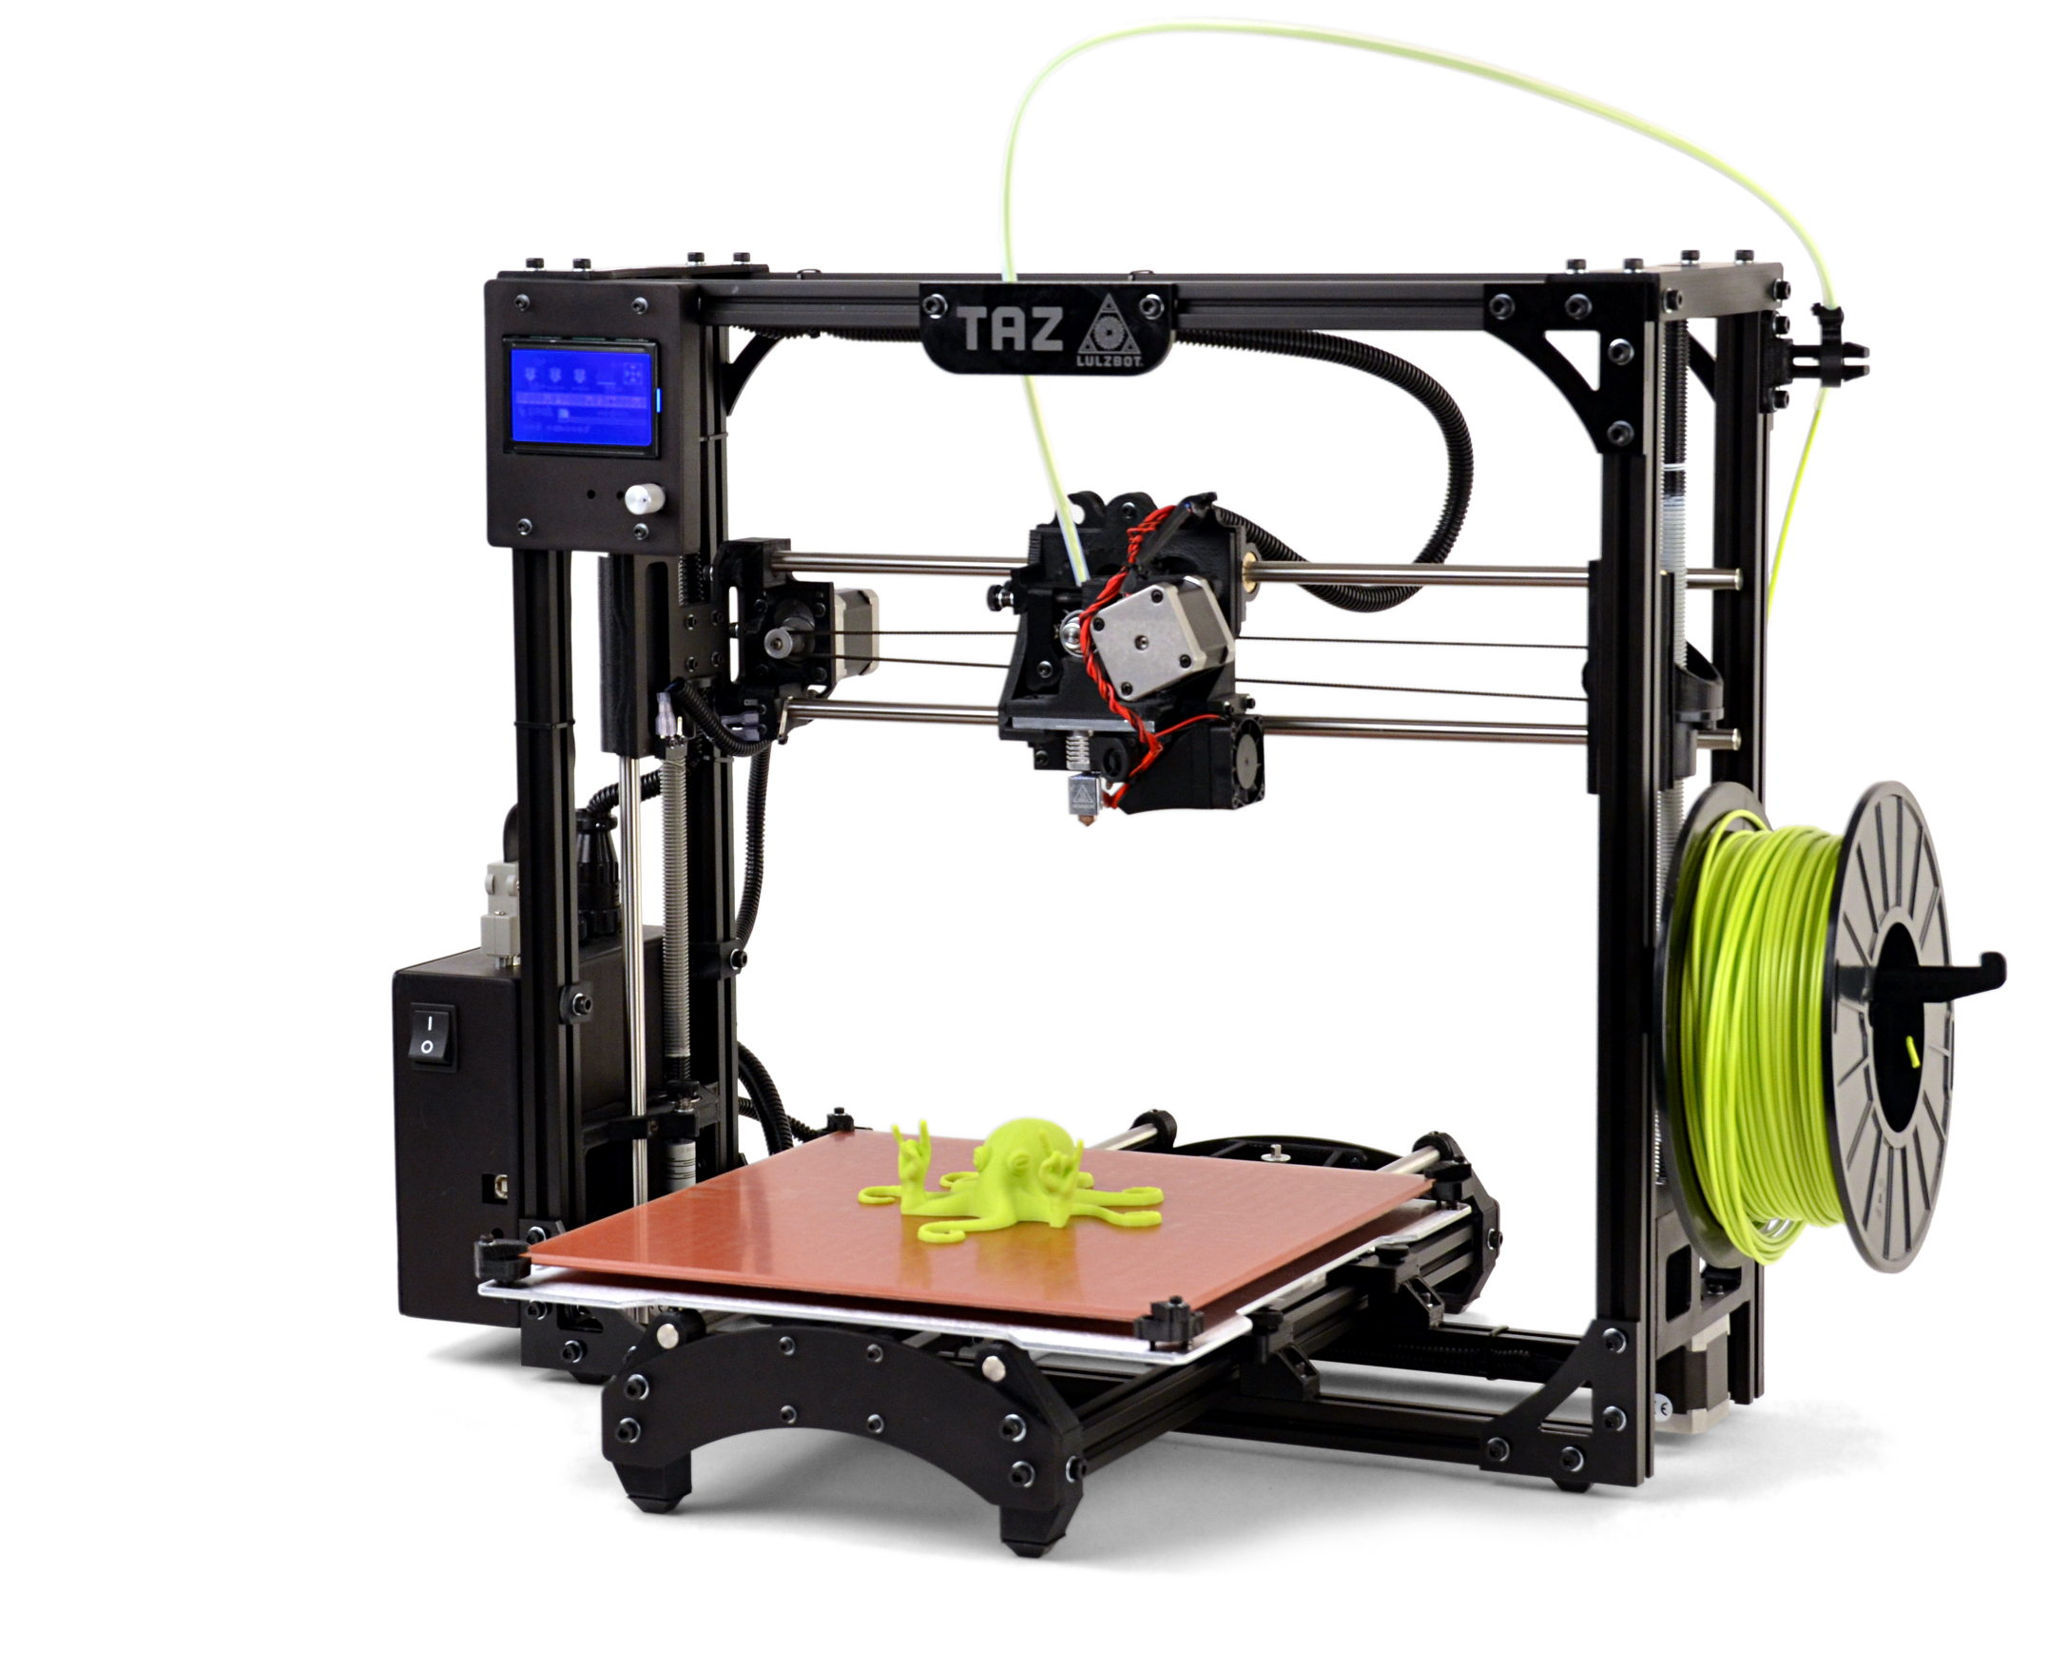
Lulzbot Taz
Control Interface
Filament
Tool Head
Hot End
Control Box / Power Supply
Heated Bed

Slide 27
Our Lulzbot
Lulzbot Taz 3
Hot end replaced w/ Hexogonal
Upgraded firmware
Side mounted heatsink fan
Side mounted bed fan
Heated bed w/ PEI film
no glue or tape required

Slide 28

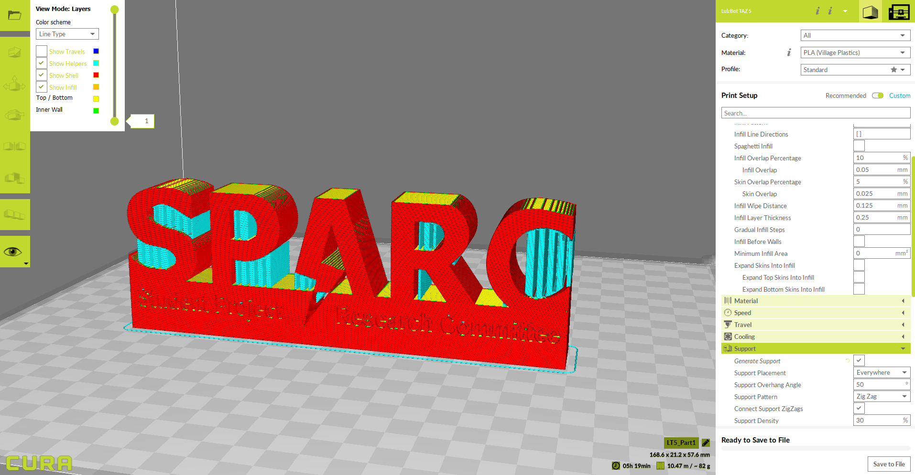
Using Cura Lulzbot Edition
Design 3D model using CAD like SolidWorks, SketchUp, Autodesk, etc.
Save model as .STL file
Open in Cura Lulzbot Edition
Set printer settings such as temperatures and fill density
Generates Gcode File that printer can interpret
Press print or save to SD card

Slide 29
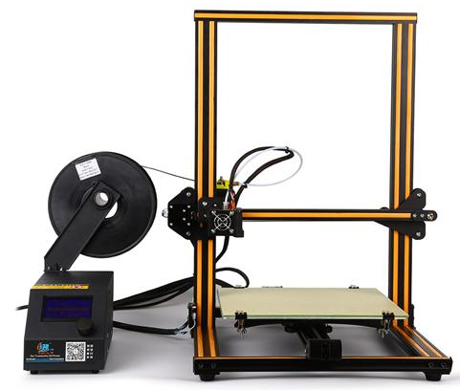
CREALITY CR10
Tool Head
Hot End
Filament
Control Box / Power Supply
Heated Bed

Slide 30
Our CR10
Creality CR10
Mostly unmodified
filmless glass bed
may require maskin tape
glue stick works for more stubborn materials
Typically used with PLA/PLA+ due to no enclosure
Uses vanilla version of Cura

Slide 31



Getting Models for 3D printing
Design your own
Professional Software: SolidWorks, Autodesk Inventor, PTC Creo
Freeware: Fusion 360, Sketch Up, OpenSCAD
Find .STL files online
Thingiverse (https://www.thingiverse.com/)
GrabCad (https://grabcad.com/)
Yeggi (https://www.yeggi.com/)

Slide 32

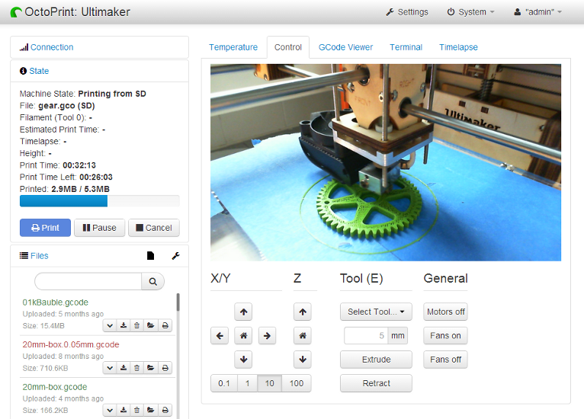
Octoprint
Local service used to manage 3D printers
Can run on a Raspberry Pi
Accessed via the network
Could streamline SPARC’s 3D printing procedure
https://www.youtube.com/watch?v=U1qguamkork&ab_channel=Ladbrotory
https://www.youtube.com/watch?v=Va5EbTQGMxw&ab_channel=AdafruitIndustries

Slide 33
QUESTIONS?

